Slide 1
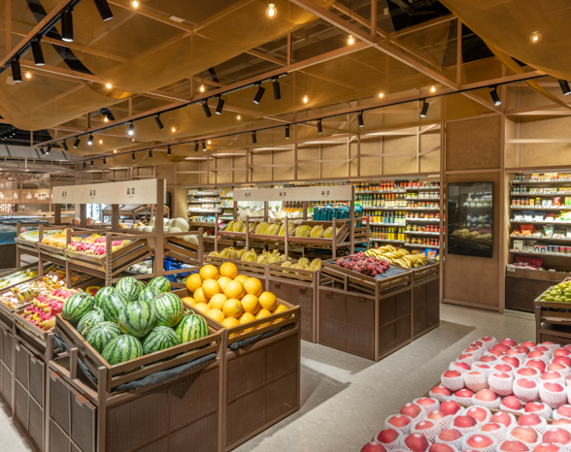
Business Analysis Super Food Markets
TIM NGUYEN

Slide 2
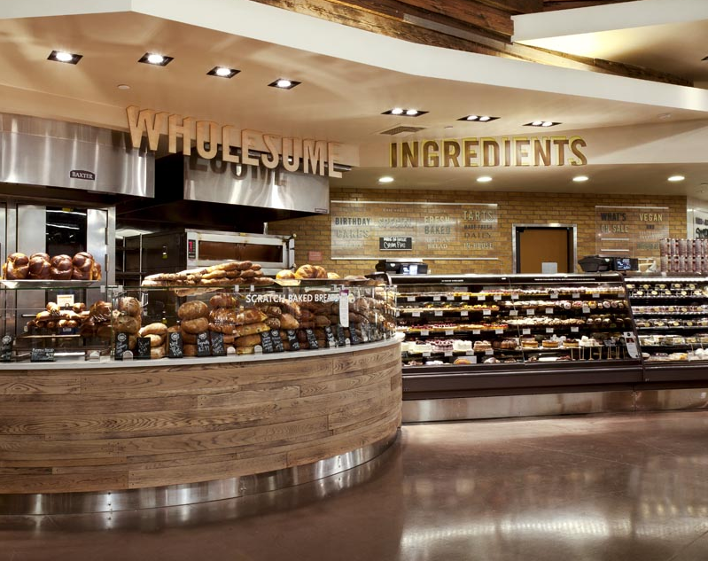
Table of Contents
Problem Statement
Business Question
Data Used
Analysis/Insights
Recommendations

Slide 3

Total Revenue Sales to Lift by 5% over the next 2 years
Problem Statement
Super Food Markets has a national market share of 8% lagging behind the Big 3…
How can Super Foods Market encourage existing customers to make more purchases whilst also attracting new customers to grow its market share?
Business Question

Slide 4
What are the popular commodities? Do different customer groups exhibit different purchasing patterns? Do customers have a brand preference between national or private? During which times of the year is there an increase in sales for popular items?
Breaking down the Business Question
BUSINESS ANALYSIS SUPER FOOD MARKETS

Slide 5
Data Used
 | Customer | Loyalty | Household | Age | Brand | Commodity | Price | Date
0 | 15803 | Loyalist | 1 adult with kids | 19-24 | private | Baked bread/buns/rolls | 0.99 | 5/10/2020
1 | 15803 | Loyalist | 1 adult with kids | 19-24 | national | Vegetables - all others | 0.70 | 24/10/2020
2 | 15803 | Loyalist | 1 adult with kids | 19-24 | national | Cold and flu | 1.68 | 18/10/2020
 | … | … | … | … | … | … | … | …
77748 | 36987 | Promiscuous | 2 adults with kids | 45-54 | national | Beef | 4.92 | 6/07/2020
77749 | 36987 | Promiscuous | 2 adults with kids | 45-54 | national | Cakes | 1.79 | 10/07/2020

Slide 6
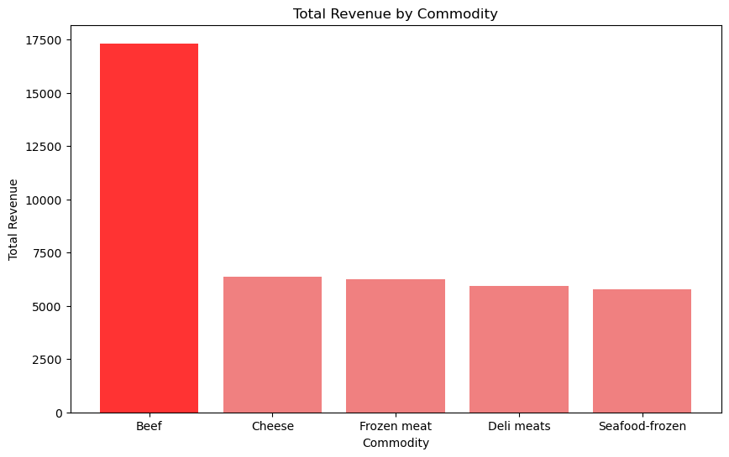
Top 5 Commodities
Beef
Top 5
Non-Top 5

Slide 7
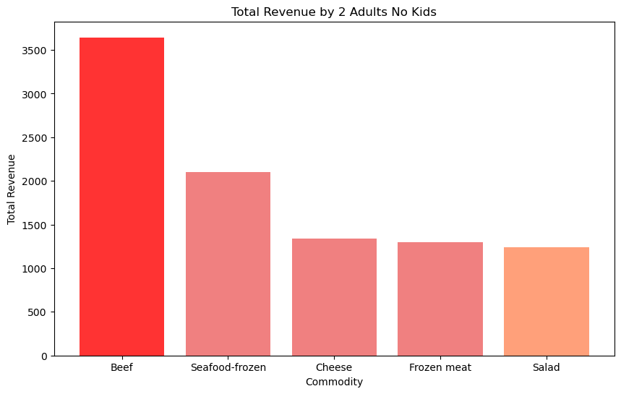
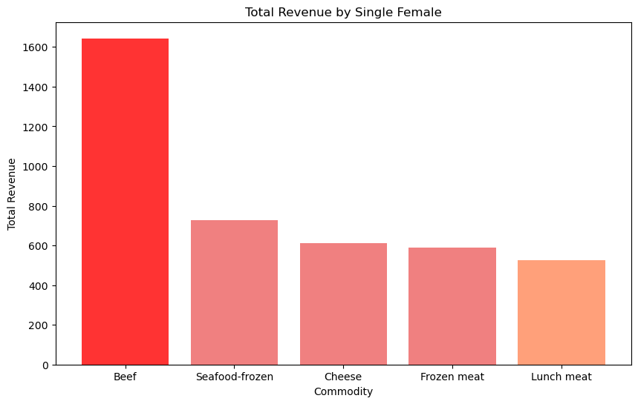
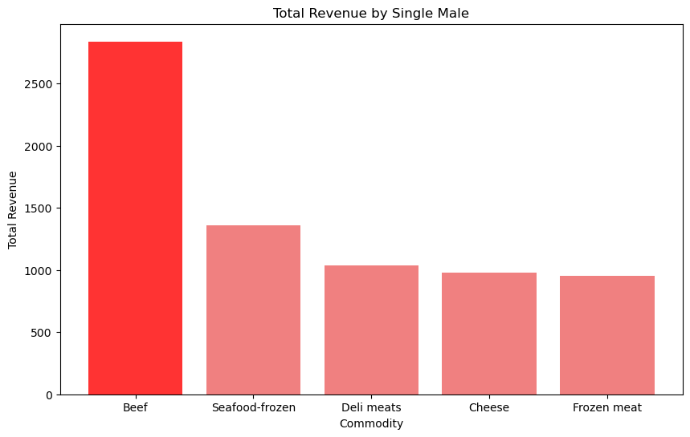
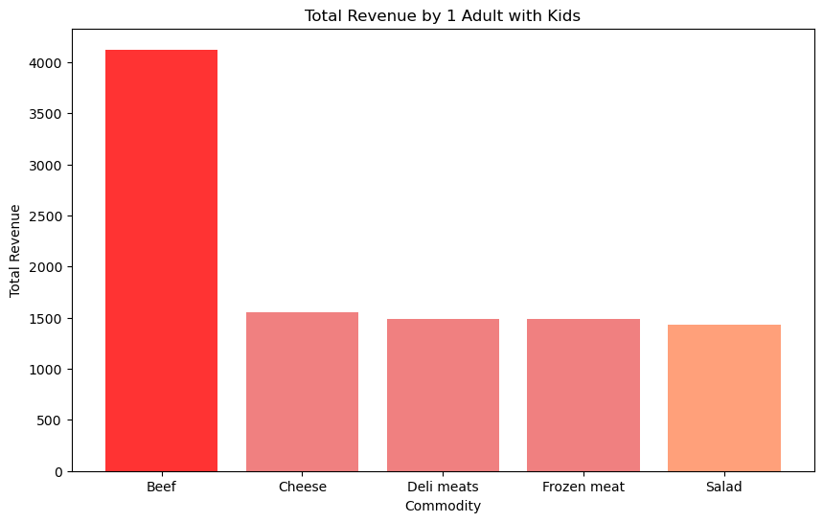
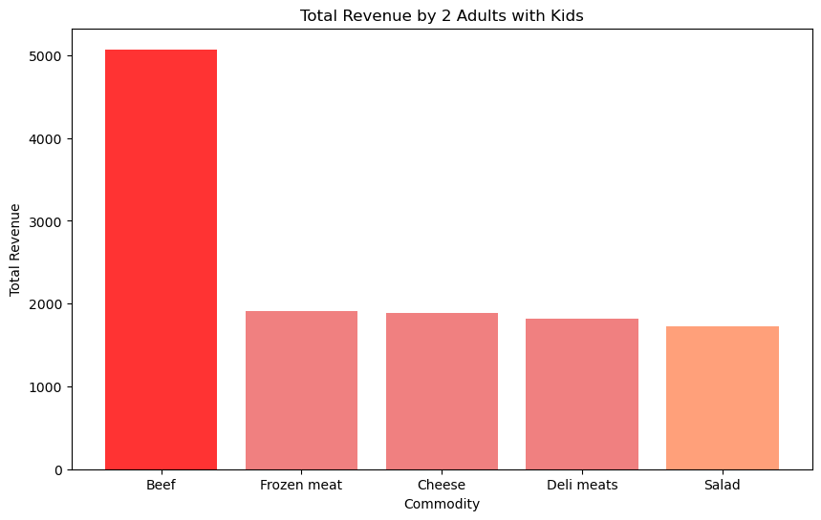
Household

Slide 8
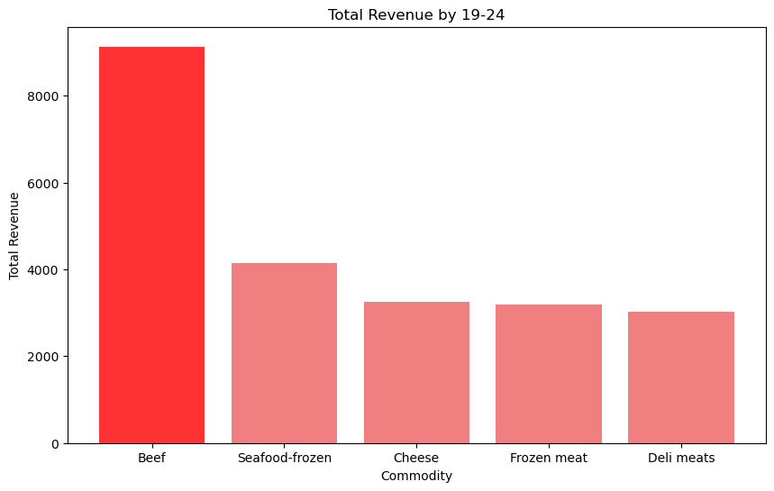
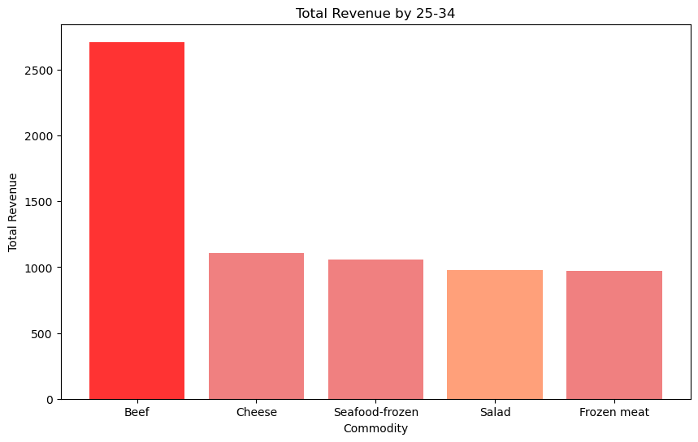
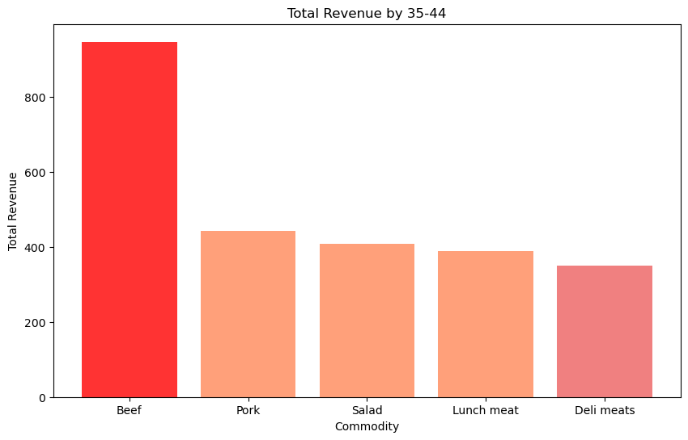
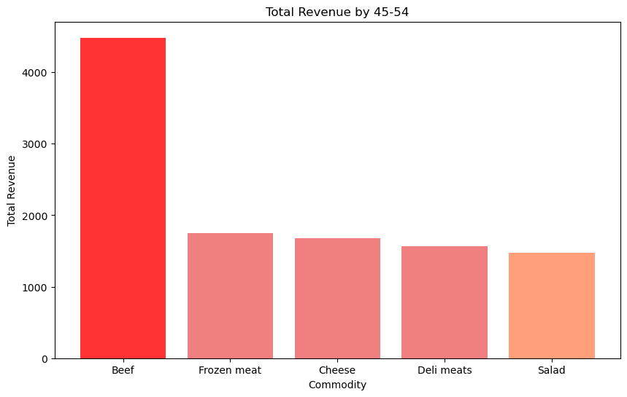
Age Groups

Slide 9
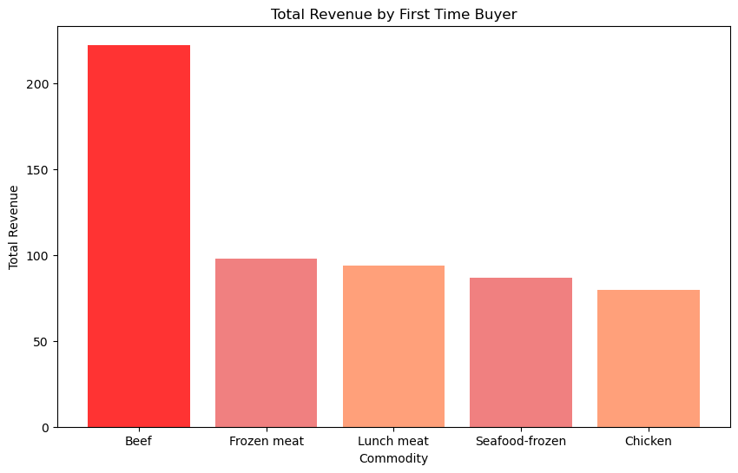
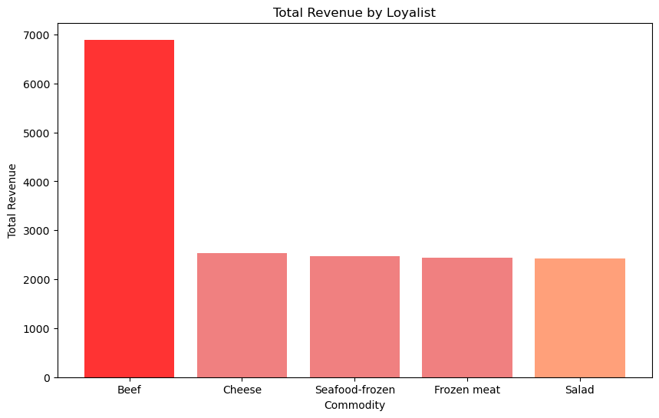
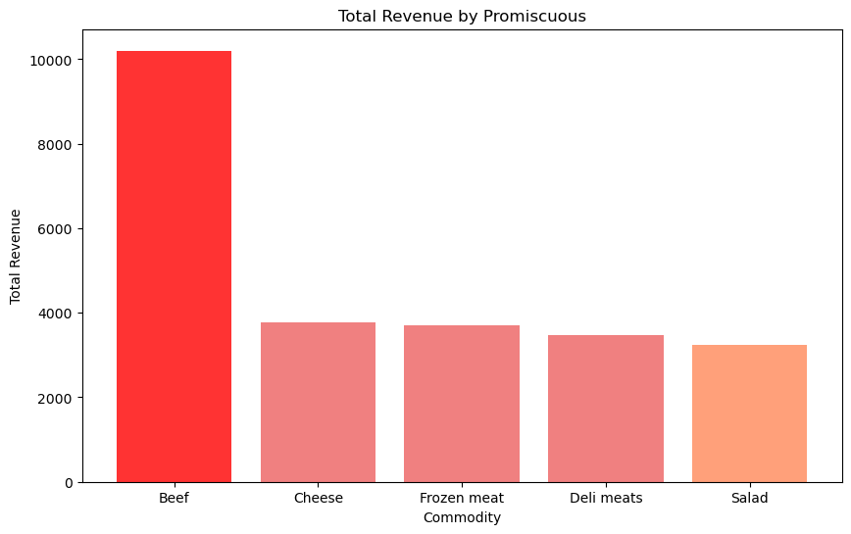
Loyalty

Slide 10

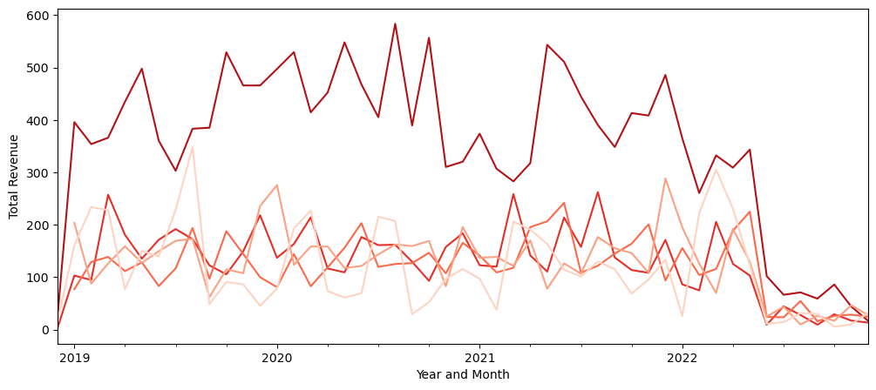
ANNUAL TRENDS
BEEF
CHEESE
DELI MEATS
FROZEN MEAT
SEAFOODFROZEN

Slide 11
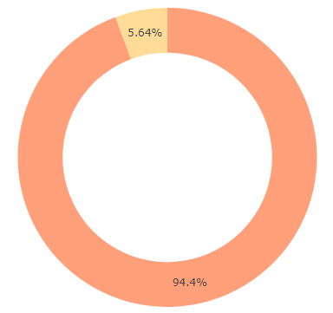
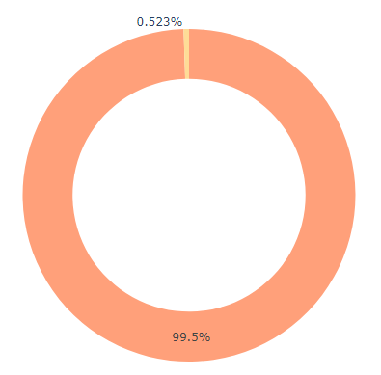
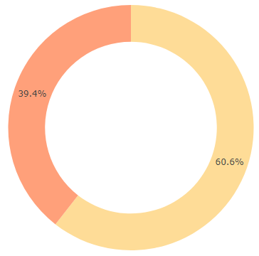
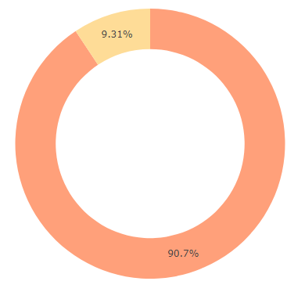
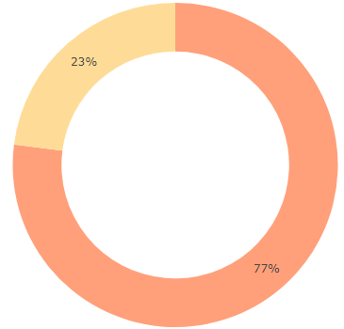
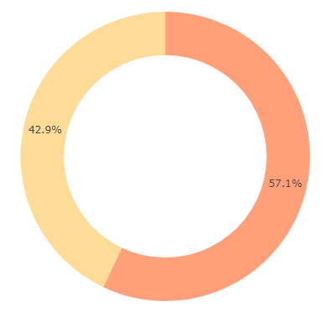
Beef
Deli Meats
National
Sea-food Frozen
Private
Frozen Meats
BRAND DISTRIBUTION
ALL COMMODITIES
Cheese

Slide 12
RECOMMENDATIONS
1
2
3
OPTIMISE PRODUCT OFFERING
TAILORED MARKETING CAMPAIGNS and INCENTIVES
STRATEGIC INVENTORY MANAGEMENT
BUSINESS ANALYSIS SUPER FOOD MARKETS

Slide 13
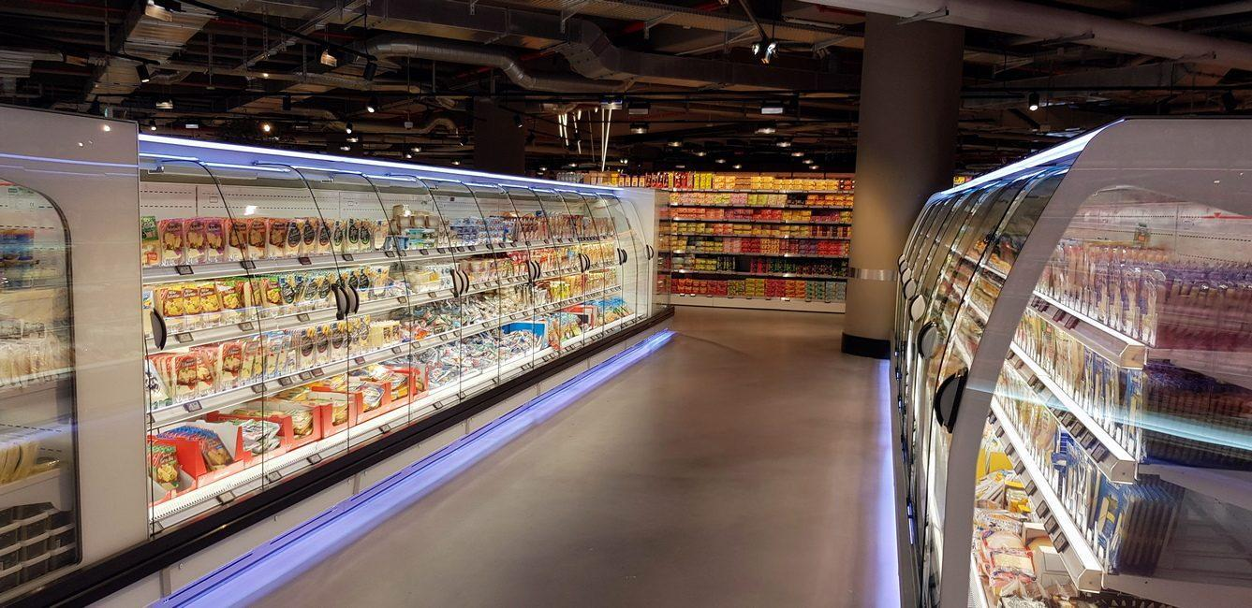
THANK YOU

